Slide 1

Driving environment perception framework based on image segmentation with traffic object content identification
Group members: Jie Li, Yong Zhang, Peipei Zhu, Junpeng Zhang
CUHKSZ Conference on Image Processing & Computer Vision 2018

Slide 2
Overview
Introduction
Methods
Experiments
Demo

Slide 3
Overview
Introduction
Methods
Experiments
Demo

Slide 4
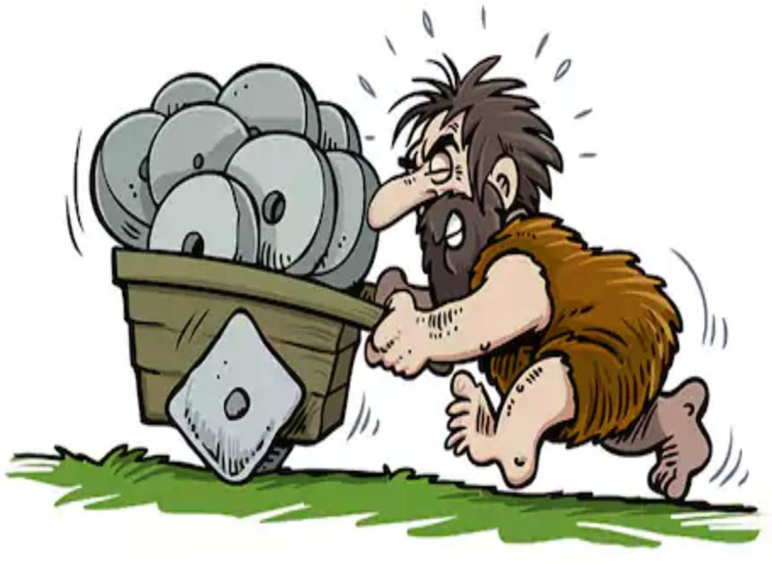
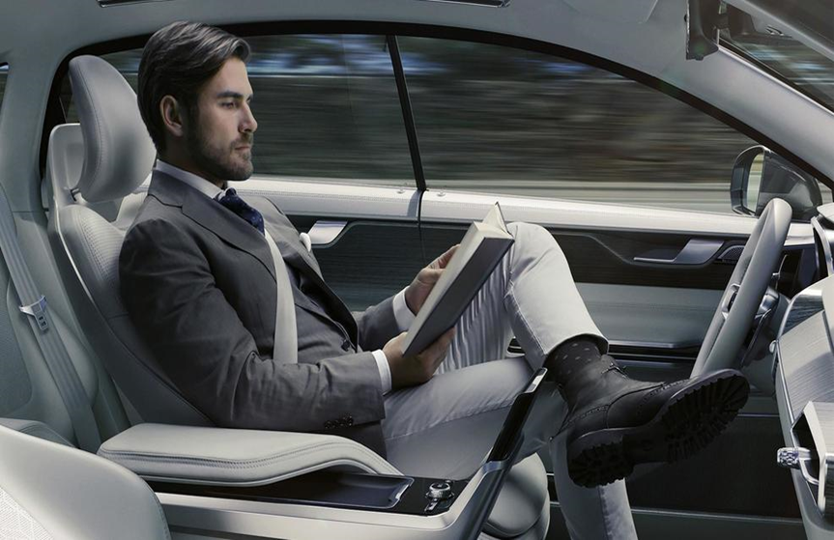
Introduction – Background
Notes:
As we know, our world is becoming more and more intelligent nowadays.
How can we make our traffic system more intelligent is a really hot topic?
Especially, many organizations are doing research on self-driving cars. It develops very rapidly.
From the technical view, in order to make our cars more intelligent, one of the most important thing is to help the car understand the driving environment.
This is the task of our project. We want build the framework to help the car understand the driving environment.

Slide 5
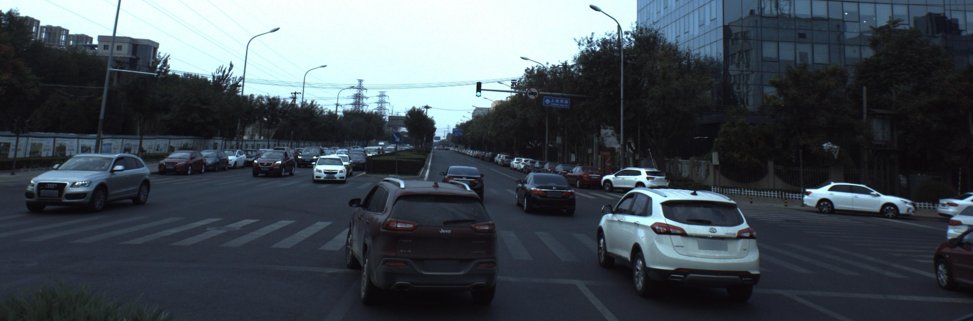
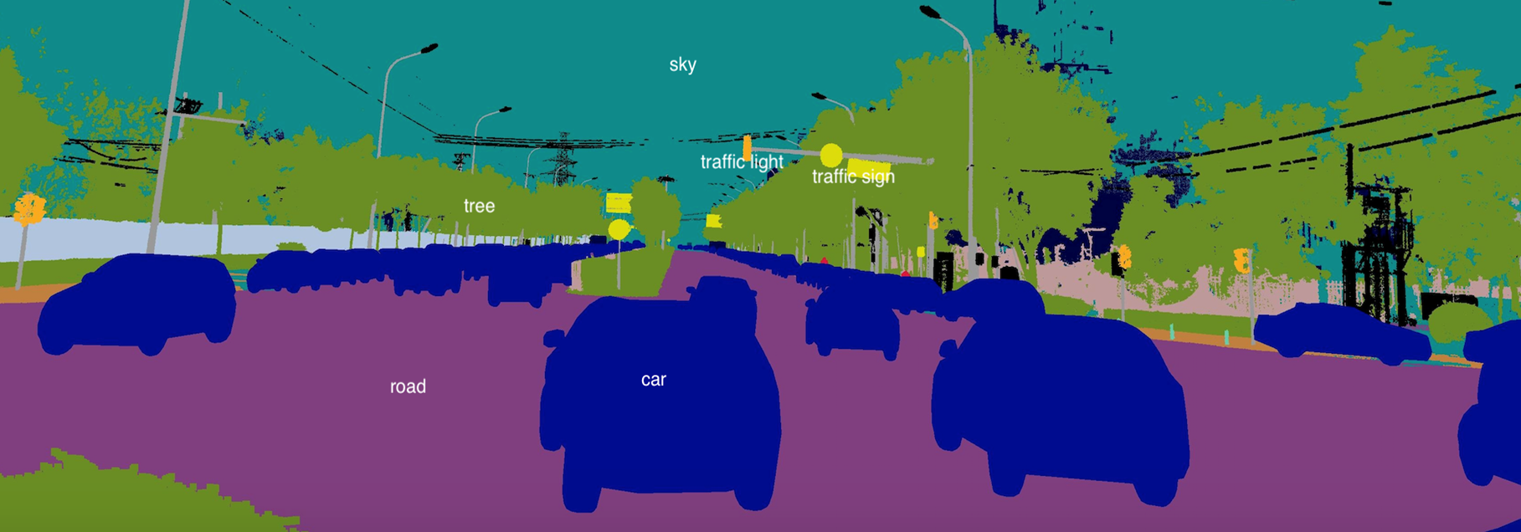
Introduction - Objective
Driving environment
Notes:
Driving environment - What is around the car when it is running on the road?
One important way to percept driving environment is to analyze the real-time images captured by cameras on the car.
Assign each pixel in the image a category label

Slide 6
Introduction - Objective
Notes:
We have to do traffic object content identification for some important object.
In the project, we will just focus on the most important 2 traffic objects: the traffic light, the road.
We pick the pixels from the original image corresponding to the object in the segmented image to analyze.
For traffic light identification, maybe analyze the color will be enough for us.
In order to identifying the lane markings on the road, we may do further segmentation for the road.
Anyway, we need to do some experiments next.

Slide 7
Introduction – Overall Architecture
Notes:
Semantic segmentation is very helpful for the car to avoid obstacles, plan routes.
But it is not enough.
Though semantic segmentation can label every pixel, it can’t extract deeper information.
For example, the car know that there is traffic light in front, but it doesn’t know whether it should go ahead, because it doesn’t know whether the light is green or red.
In conclusion, by semantic segmentation, the car know what object is around, but the car doesn’t know the detailed information of the object.
This leads to our next task: traffic object content identification.

Slide 8
Overview
Introduction
Methods
Experiments
Demo

Slide 9
Comparison of different Semantic Segmentation Models
FC-DenseNet
3 Models
DeepLabv3
DeepLabv3+
Notes:
Because our project focuses on Applications, we tested 3 different semantic segmentation models in auto-driving application.

Slide 10
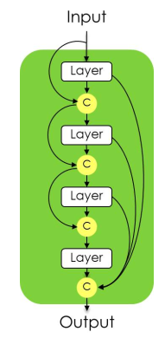
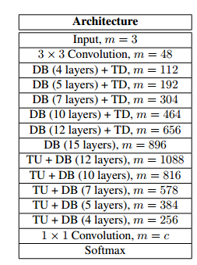
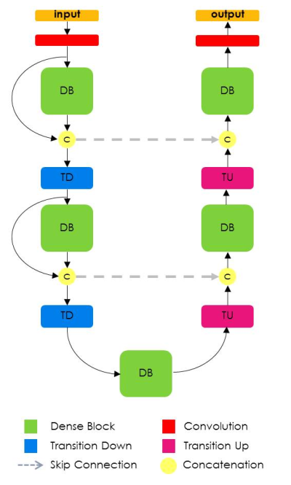
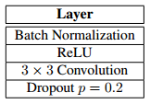
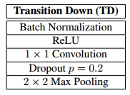
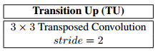
Semantic Segmentation Models—FC-DenseNet
FC-DenseNet103 model
fFADD
A dense block of 4 layers
FC-DenseNet
Notes:
The first model is FC-DenseNet model, The idea of DenseNets is based on the observation that if each layer is directly connected to every other layer in a feed-forward fashion then the network will be more accurate and easier to train.
The FC-DenseNet model was extended from DenseNets to work as FCNs by adding an upsampling path to recover the full input resolution. In order to solve large amount of computation and number of parameters problem, FC-DenseNet only upsample the feature maps created by the preceding dense block. Moreover, given the network architecture, the upsampled dense block combines the information contained in the other dense blocks of the same resolution. The higher resolution information is passed by means of a standard skip connection between the downsampling and the upsampling paths. The details of FC-DenseNet model are shown in the Figure

Slide 11
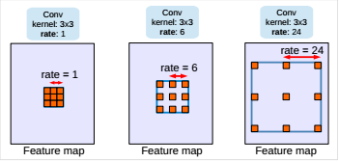
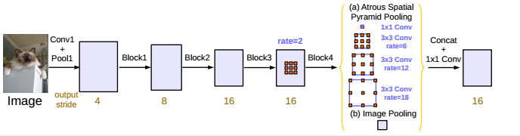
Semantic Segmentation Models--DeepLabv3
Frontend:ResNet-101
Atrous convolution with kernel size 3*3 and different rate
Parallel modules with atrous convolution (ASPP), augmented with image-level features
Notes:
The second network we chose is the deeplab v3，we revisit atrous convolution, a powerful tool to explicitly adjust filter’s field-of-view as well as control the resolution of feature responses computed by Deep Convolutional Neural Networks, in the application of semantic image segmentation. To handle the problem of segmenting objects at multiple scales, we design modules which employ atrous convolution in cascade or in parallel to capture multi-scale context by adopting multiple atrous rates. Furthermore, we propose to augment our previously proposed Atrous Spatial Pyramid Pooling module, which probes convolutional features at multiple scales, with image-level features encoding global context and further boost performance.

Slide 12
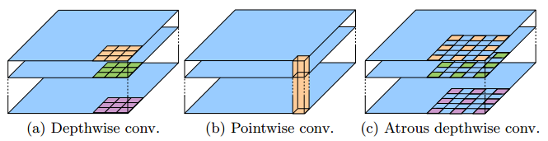
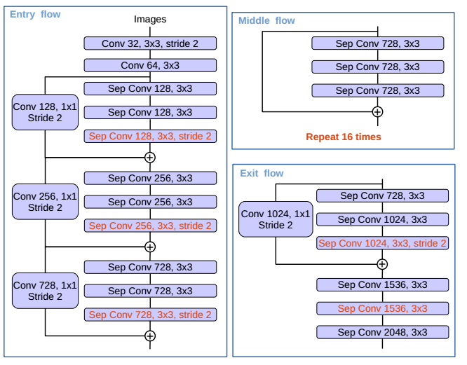
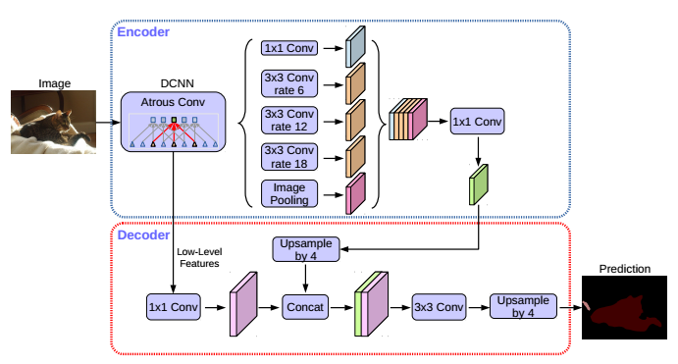
Semantic Segmentation Models--DeepLabv3+
Frontend:ResNet-101
Notes:
DeepLabv3+ extends DeepLabv3 by employing a encoder decoder structure. The encoder module encodes multi-scale contextual information by applying atrous convolution at multiple scales, while the simple yet effective decoder module refines the segmentation results along object boundaries.
We further explore the Xception model and apply the depthwise separable convolution to both Atrous Spatial Pyramid Pooling and decoder modules, resulting in a faster and stronger encoder-decoder network.

Slide 13
Overview
Introduction
Methods
Experiments
Demo

Slide 14
Experiments
Notes:
Here is overview of our experiment, which includes 2 stages: the environment segmentation stage, and the lane mark identification stage.
Firstly, for the environment segmentation stage, the input is the original color image, and the output is a label image, which contains the object label for each pixel.
Then, for the lane mark identification stage, we pick out the pixels belonging to road from the original image as the input, and the output is the lane mark labels.
Finally, we combine the outputs of two stages, and generate a fine-grained segmented image.
This image is very meaningful for decision-making of self-driving cars.
Not only does the car know where is the road, it also knows what kinds of lane marks on the road.

Slide 15
Experiments
Experiment environment
Ubuntu Linux, 32-core CPU, Titan GPU
Python + TensorFlow
Deep learning models
FC-DenseNet, DeepLabV3, DeepLabV3_plus
Dataset (Based on Baidu‘s Apollo dataset)
Notes:
Our program is implemented with python and tensorflow, and it runs with Titan GPU.
And we use 3 models to train our prediction model as we mentioned before.
Based on Baidu’s Apollo dataset, we build 2 dataset for each stage.
Each dataset has 500 images for training, 200 images for testing and validation.
For the environment segmentation , we define 37 object labels.
For the lane mark identification, we define 12 object labels.

Slide 16
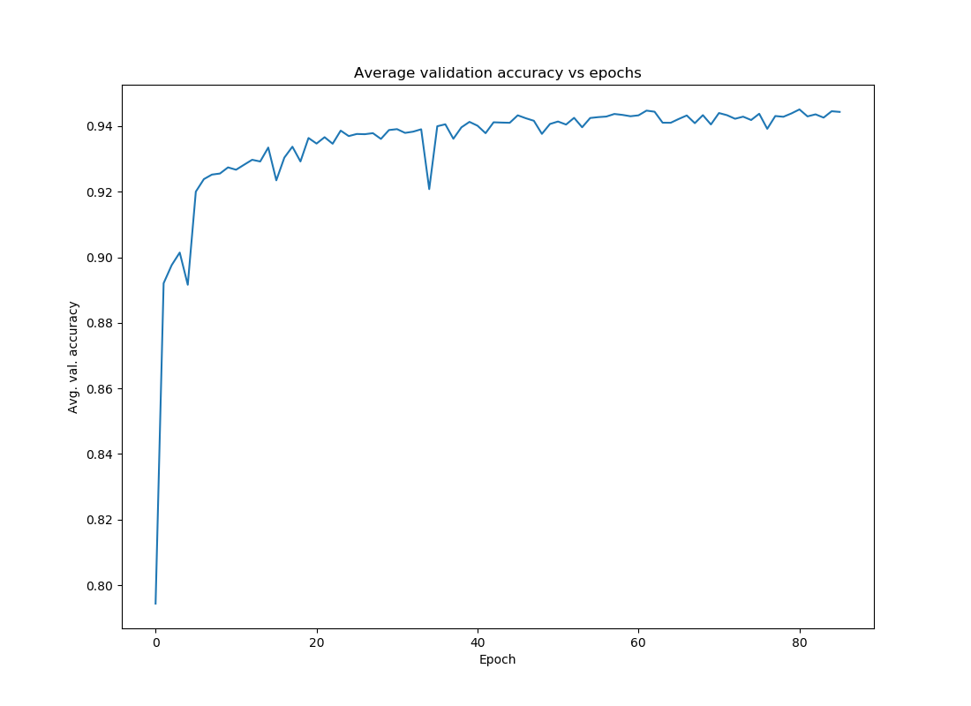
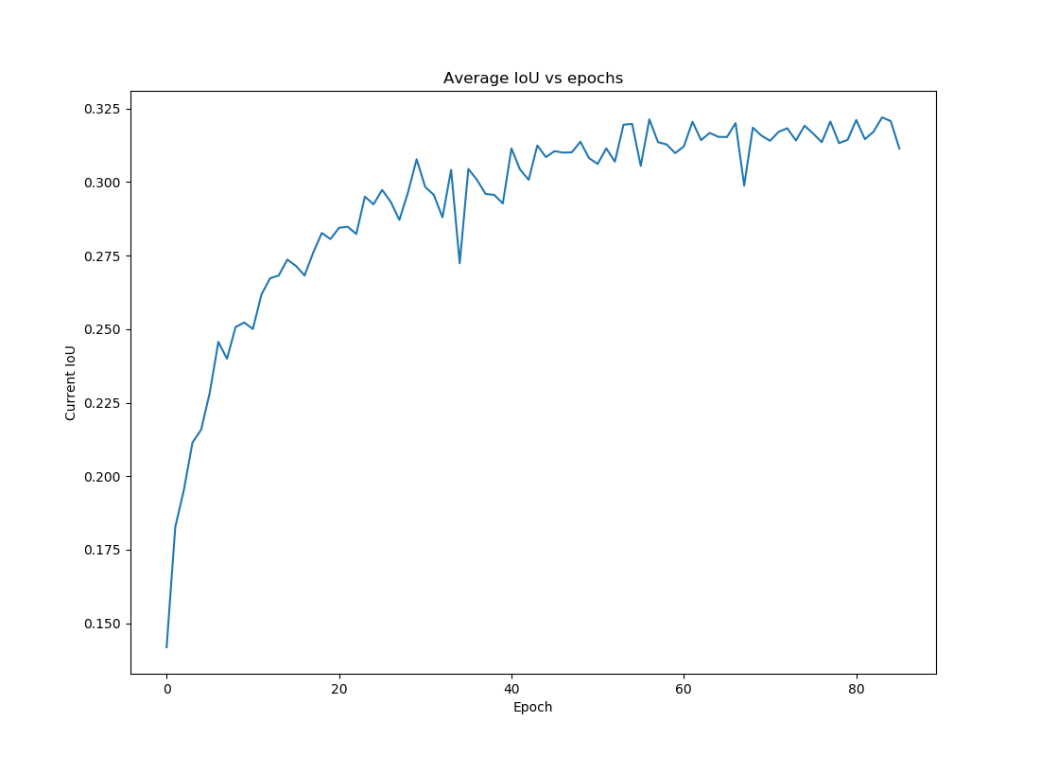
Experiments – Environment segmentation
Training curves (FCN)
Testing results
Notes:
Here are results for the environment segmentation.
The above images shows the training curves.
One is the average IoU, and the other is the validation accuracy.
We can see that these 2 criterions tend to converge for about 100 epochs.
The following table shows the testing results.
DeepLabV3_plus has the much better performance than other 2 models.
The best IoU is about 0.42

Slide 17
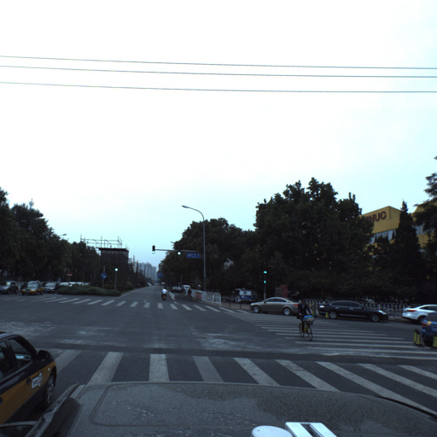
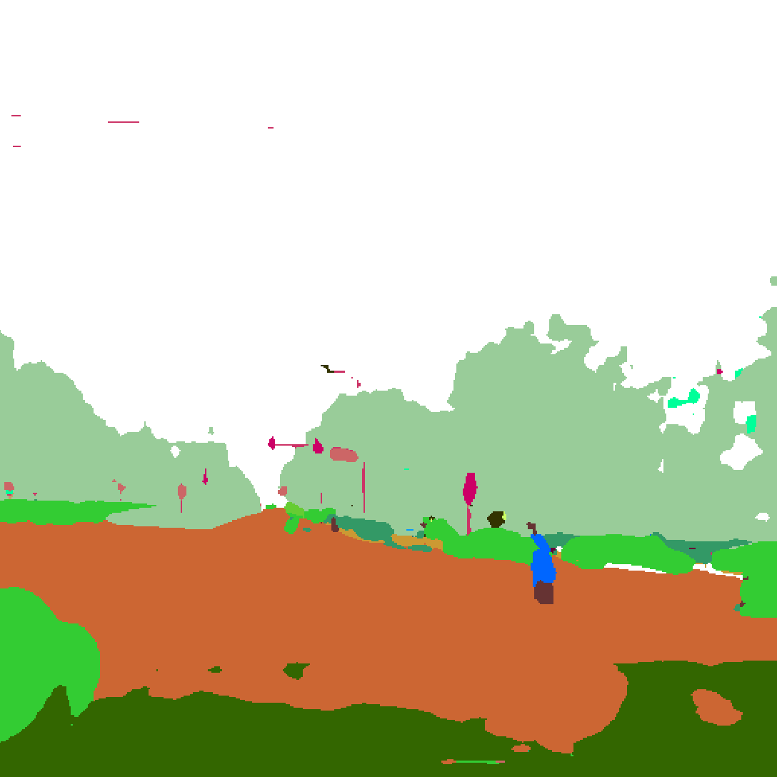
Experiments – Environment segmentation
Notes:
Here are an input example and output example.

Slide 18
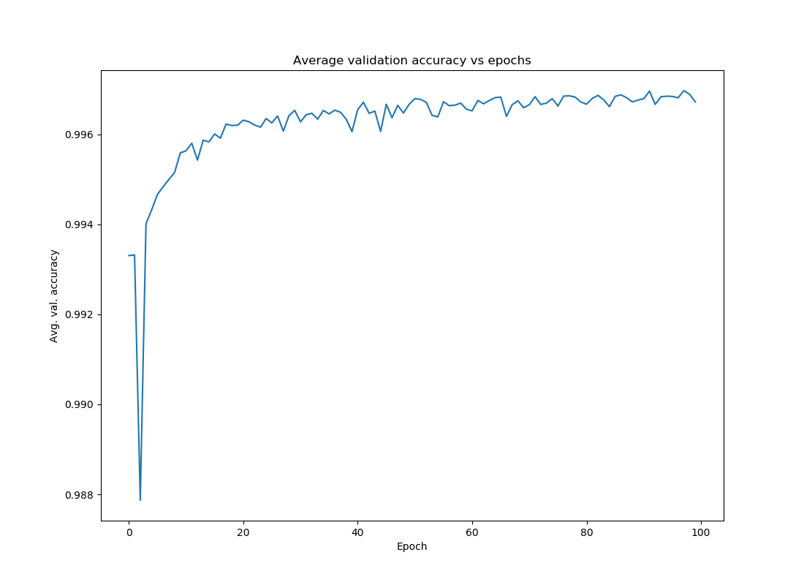
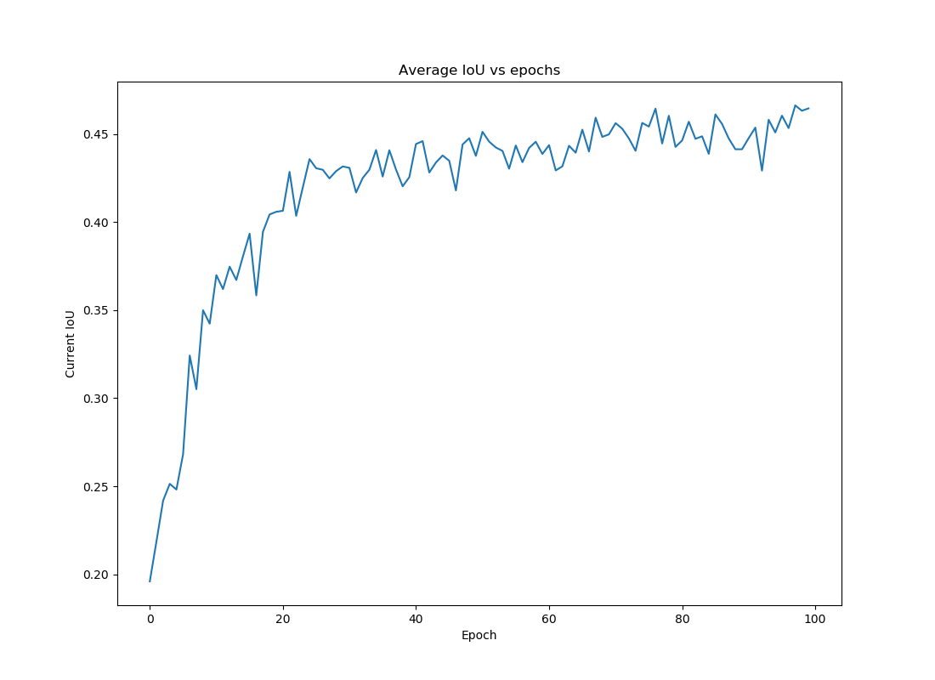
Experiments – Lane mark identification
Training curve (DeepLabV3_plus)
Testing results
Notes:
Here are the results for the lane mark identification.
Since DeepLabV3_Plus has the best performance, we only use this model in this stage.
We see that the final average mean IoU is about 0.43.
A little higher than environment segmentation.

Slide 19
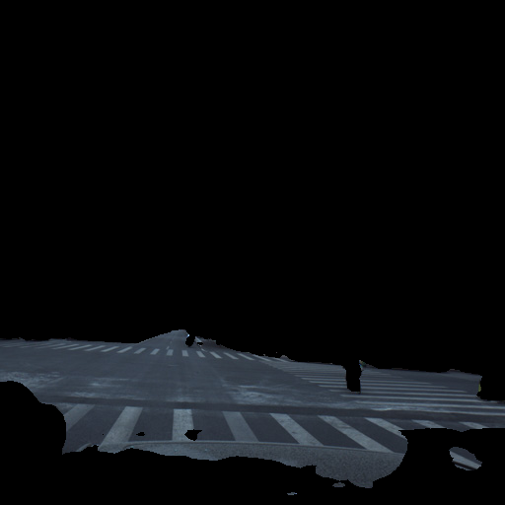
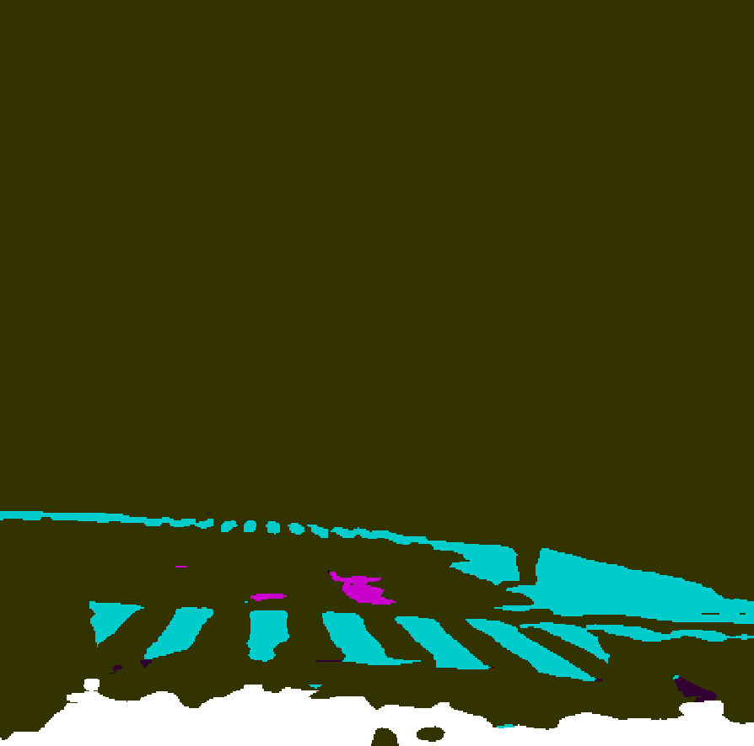
Experiments – Lane mark identification
Notes:
Here are example input and output.

Slide 20
Experiments – Discussion
DeepLabV3_plus model has the best performance
Environment segmentation: average IoU = 0.42 (the best published result is 0.43)
Lane mark identification: average IoU = 0.43 (no published result to compare)
Only take about 0.03 second to test one image
Notes:
The average IoU for environment segmentation
The average IoU for lane mark identification is 0.45.
We have not find any published work for lane mark segmentation.
So we can’t compare.
DeepLabV3_plus has the best prediction accuracy.
It has Pre-training process.
Next, Junpeng will present a demo based on our models.

Slide 21
Overview
Introduction
Methods
Experiments
Demo

Slide 22
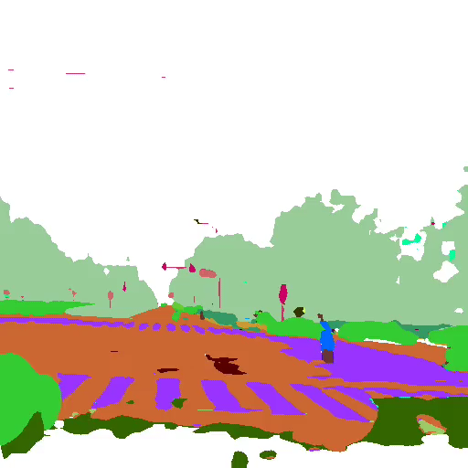

Slide 23
Thank you

